Slide 1
Chapter 10 The Economic, Social and Environmental Impacts of Winter Sport Tourism
Simon Hudson

Slide 2
Topic Covered
Impacts of winter sport tourism
Economic impacts
Social impacts
Environmental impacts
The impact of climate change on winter sport tourism

Slide 3
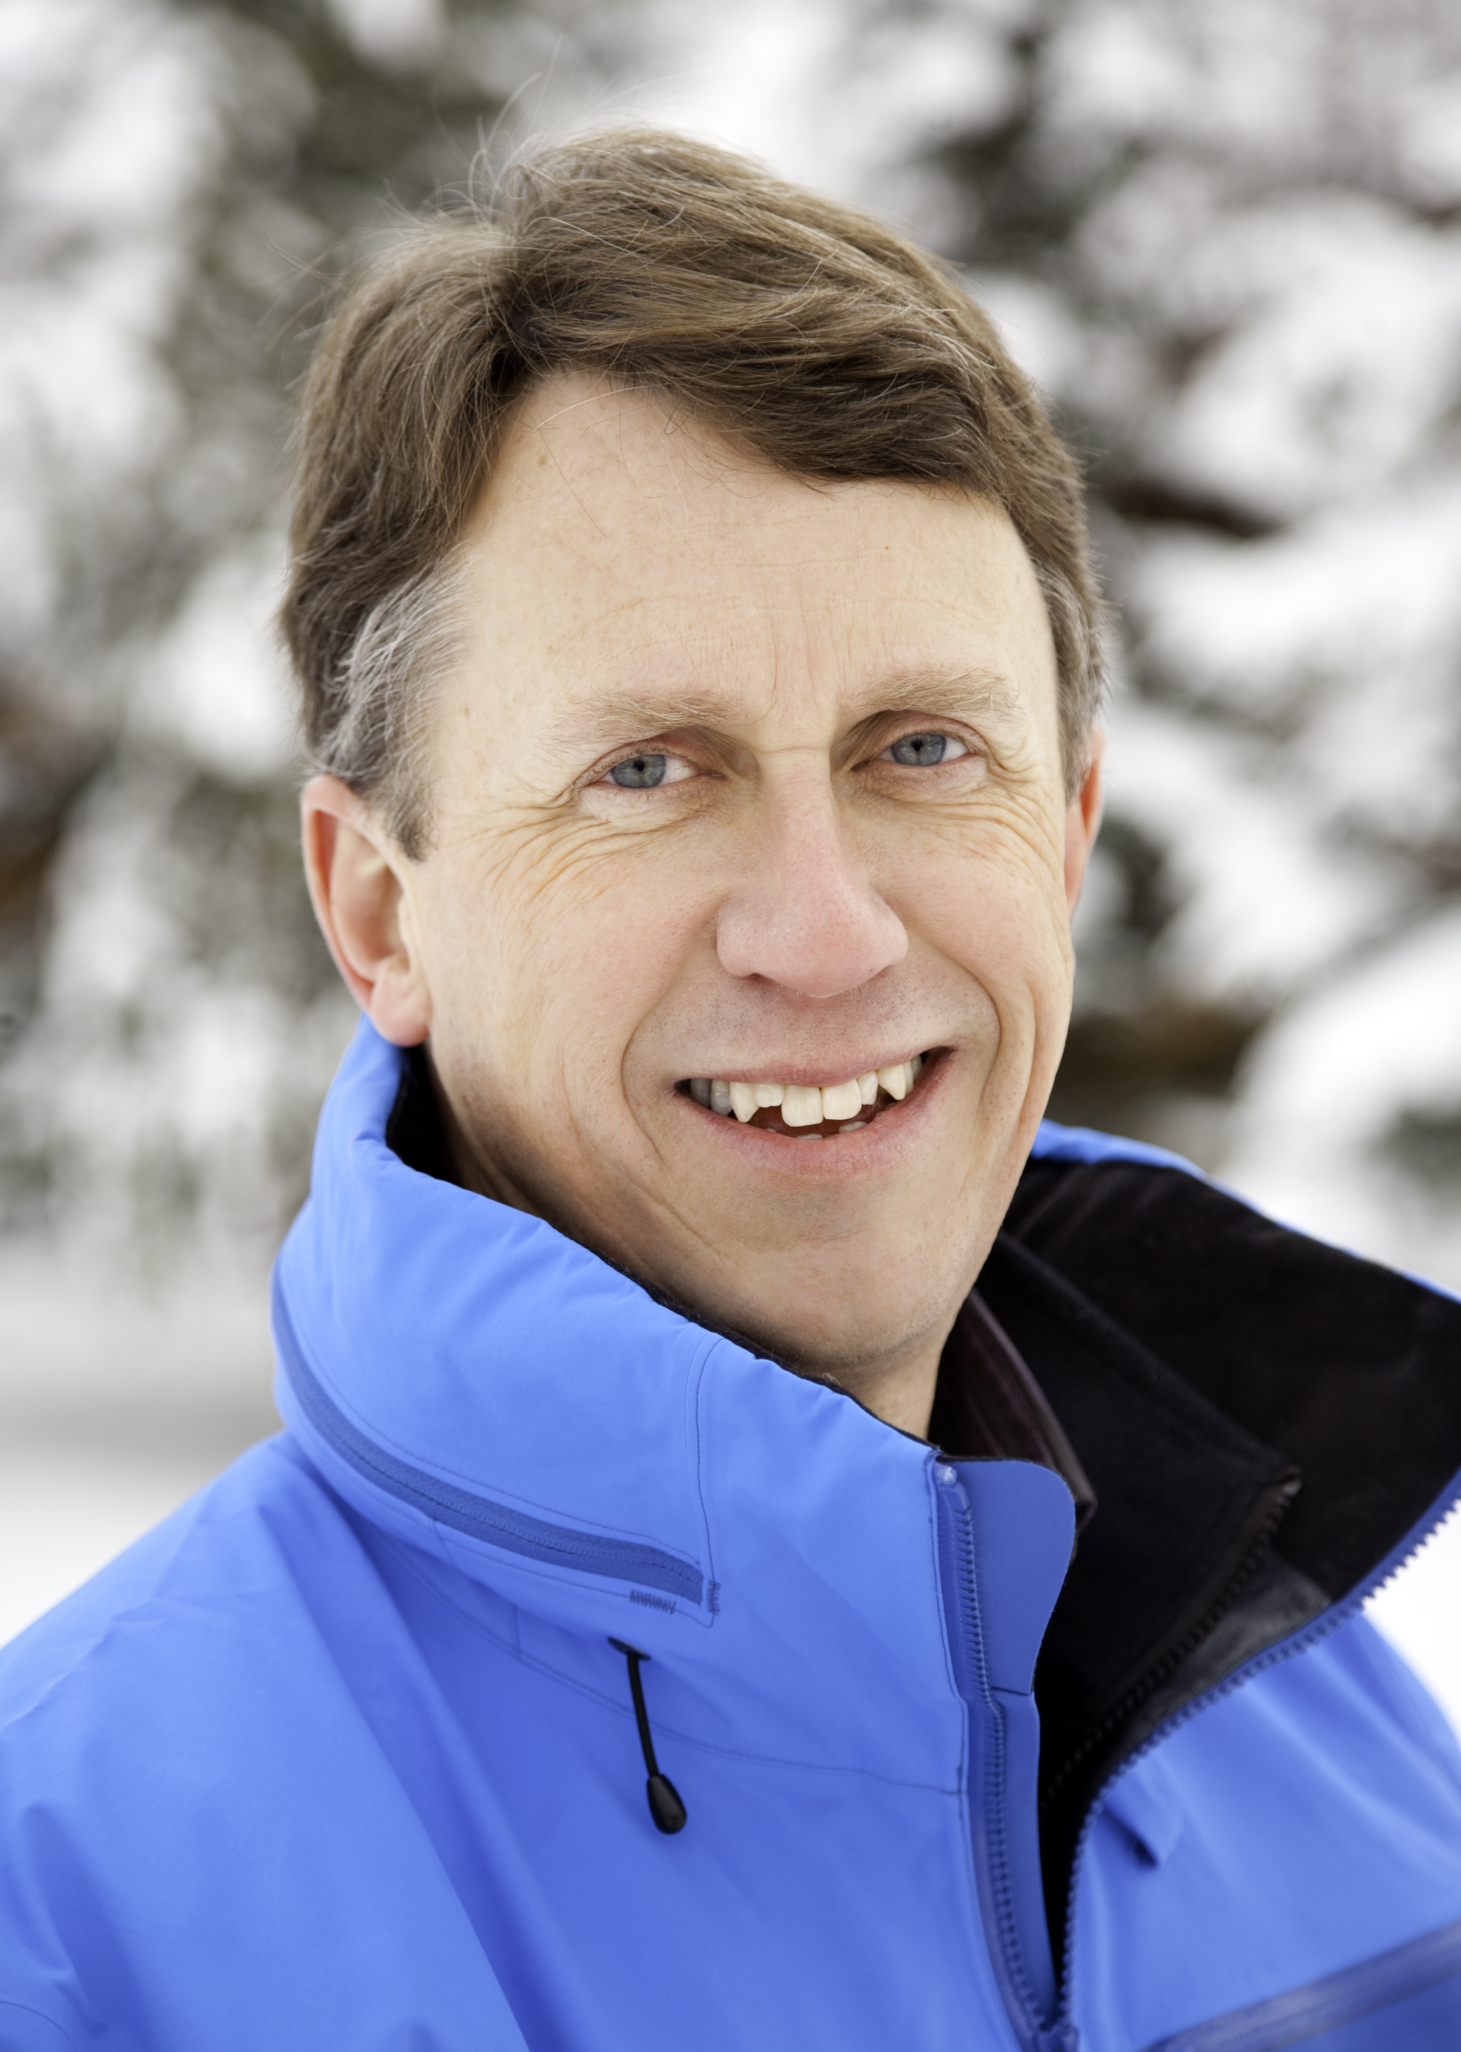
Spotlight - Dave Butler: A heli of a job
Heli-tourism
negative environmental impacts
Canadian Mountain Holidays
commitment to the environment
responsibility and social/cultural stewardship
increase energy efficiency
waste reduction

Slide 4
Impacts of winter sport tourism
Three pillars of sustainability
The economy, the environment and society
Positive and negative impacts of winter sport tourism

Slide 5
Positive and negative impacts of winter sport tourism
Advantages | Disadvantages
Employment and income benefits, both direct and indirect | Overdependence on tourism
Tax benefits to local, regional and national governments | Raises property prices beyond the reach of local young people
Attracts the higher-spending social groups | Leads to an increase in road traffic
Health benefits | Resident hostility towards tourists
Positive contribution to quality of life | Negative impact on wildlife
Catalyst for positive social change | Pollution
Increases local property values | Soil erosion
Quality of tourism increases | Displacement through land occupancy
Counteracts problems of seasonality | Heavy use of water for snow making
Improved recreation facilities for local communities | Creates pressures on land

Slide 6
Economic impacts
Four factors have contributed to both the emphasis on economic impact analysis
Lure strong foreign currency, and spur economic grow
Increasing economic impact studies growth
A negative impact on revenues from warmer winters

Slide 7
Model projections of national employment difference, good snow years vs. bad snow years
 |  | With Replacement Consumer Spending |  | Without Replacement Consumer Spending
 | 2010 Employment | Employment Difference (# of jobs) | Percent Change | Employment Difference (# of jobs) | Percent Change
Direct | 125,300 | -16,455 | -13% | -16,455 | -13%
Indirect | 31,400 | -3,775 | -12% | -3,775 | -12%
Induced | 55,200 | 7,265 | 13% | -6,600 | -12%
Total | 211,900 | -12,965 | -6% | -26,830 | -13%
Source: Courtesy of NRDC, 2012, p. 15

Slide 8
Model projections of difference in national economic value added, good snow years vs. bad snow years
 |  | With Replacement Consumer Spending |  | Without Replacement Consumer Spending
 | 2010 Value Added ($billions) | Difference in Value Added ($ millions) | Percent Change | Difference in Value Added ($ millions) | Percent Change
Direct | $4.90 | $(797) | -16% | $(797) | -16%
Indirect | $2.90 | $(447) | -15% | $(447) | -15%
Induced | $4.40 | $434 | 10% | $(690) | -16%
Total | $12.20 | $(810) | -7% | $1,934 | -16%
Source: Courtesy of NRDC, 2012, p. 15

Slide 9
Social impacts
Concerned with the tourist, the host, and tourist-host interrelationships
A few theoretical frameworks (a negative light)
Arguments opposing winter sport tourism
Find solutions to social problems

Slide 10
Doxey’s Index of Irritation
Stages of Development | Residents Attitudes Towards Tourism
Euphoria | Initial phase of development, visitors and developers welcome, little planning or control mechanism.
Apathy | Visitors taken for granted, contacts between residents and outsiders more formal (commercial), planning concerned mostly with marketing
Annoyance | Saturation points approached, residents have misgivings about tourism industry, policymakers attempt solutions via increasing infrastructure rather than limiting growth.
Antagonism | Irritations openly expressed, visitors seen as cause of all problems, planning now remedial but promotion increased to offset deteriorating reputation of destination.
Source: Adapted from Doxey, 1976, p. 26

Slide 11
Host attitudinal/behavioral responses to tourist activity
Source: Adapted from Wall & Mathieson, 2006

Slide 12
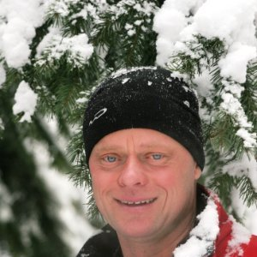
Profile Keeping Whistler wild
Whistler Blackcomb‘s sustainability
as close to zero footprint as possible
building partnerships
Other programs
wide scale recycling, organic waste composting, reduction of single use cups

Slide 13
Environmental impacts
Development of higher resorts
Construction and enlargement of ski resorts
Opposition to ski resort expansion and development
A conceptual model for corporate greening

Slide 14
The impact of climate change on winter sport tourism
Methodologies used to predict the effects of climate change on winter sports
Questioned key stakeholders about their perceptions related to climate change
Friendly policies and practices

Slide 15
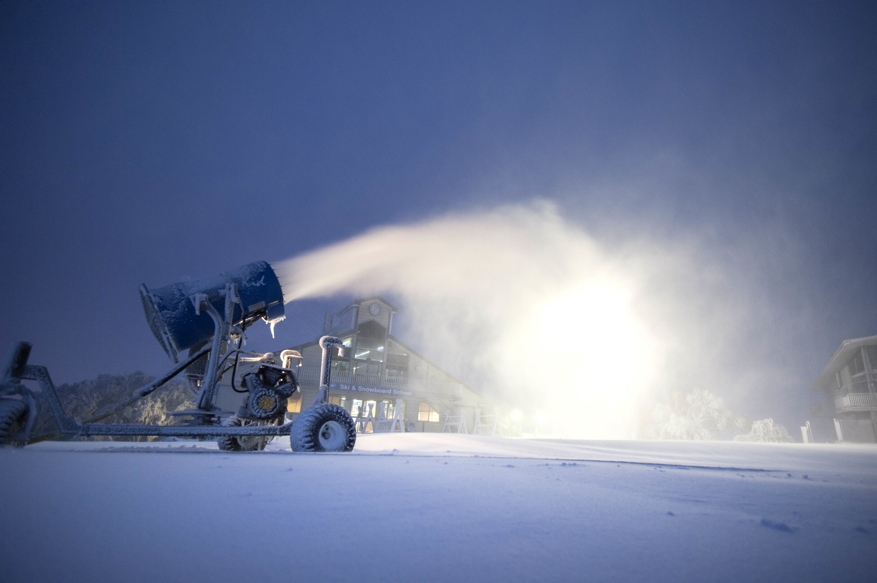
Case study Recycling snow ‘Down Under’
Mt Buller and Mt Stirling ski in eco-tourism
issue of producing artificial snow to bolster natural snowfalls.

